Slide 1
INFORMATION SYSTEM DEVELOPMENT OVERVIEW
Notes:
This repository of slides is intended to support the named chapter. The slide repository should be used as follows:
Copy the file to a unique name for your course and unit.
Edit the file by deleting those slides you don’t want to cover, editing other slides as appropriate to your course, and adding slides as desired.
Print the slides to produce transparency masters or print directly to film or present the slides using a computer image projector.
Each slide includes instructor notes. To view those notes in PowerPoint, click left on the View Menu; then click left on Notes View sub-menu. You may need to scroll down to see the instructor notes.
The instructor notes are also available in hard copy as the Instructor Guide to Accompany Systems Analysis and Design Methods, 5/ed. Contact your Irwin/McGraw-Hill sales representative if you need a hard copy.

Slide 2
Session objectives
Describe the motivation for a system development process in terms of the Capability Maturity Model (CMM) for quality management.
Differentiate between the system life cycle and a system development methodology.
Describe eight basic principles of system development.
Define problems, opportunities, and directives—the triggers for systems development projects.
Describe the PIECES framework for categorizing problems, opportunities, and directives.
Describe the traditional, basic phases of system development. For each phase, describe its purpose, inputs, and outputs.
Describe cross life cycle activities that overlap all system development phases.
Describe four basic alternative “routes” through the basic phases of system development. Describe how routes may be combined or customized for different projects.
Notes:
No additional notes

Slide 3
The Process of Systems Development
A system development process is a set of activities, methods, best practices, deliverables, and automated tools that stakeholders use to develop and maintain information systems and software.
Stakeholders include system owners, system users, system designers, system builders, system analysts, IT vendors and consultants.
Notes:
Some textbooks use the term systems development life cycle. We elected not to use that term because it invokes negative connotation for many instructors. Some associate it with a pure waterfall development approach (which we consider unfair).
We differentiate between development and operation (sometimes called production). This chapter focuses on development and different methodologies and strategies employed for system development.

Slide 4
Some definitions
Business Process Management (BPM) - a methodology used by organizations to continuously improve end-to-end business processes.
BPM Process
Defining and mapping the steps in a business process.
Creating ways to improve on the steps in the process that add value
Finding ways to eliminate or consolidate steps in the process that do not add value
Creating and adjusting electronic workflows to match the improved process maps.
Business process automation (BPA) – technology components used to complement or substitute manual process.

Slide 5
(Some definitions cont’d)
Business process improvement (BPI) – creating new, re-designed processes to improve the workflows, and/or utilizing new technologies enabling new process structures.
Business process reengineering (BPR) – changing the fundamental way in which the organization operate.
System Request - The document that describes the business reasons for building a system and the value that system is expected to provide. The project sponsor usually completes this form as part of a formal system selection process within the organization.
The business requirements of the project refer to the business capabilities that the system will need to have.
The business value describes the benefits that the organization should expect from the system.

Slide 6
The CMM Process Management Model
The Capability Maturity Model (CMM) is a framework to assess the maturity level of an organization’s information system development and management processes and products. It consists of five levels of maturity as measured by a set of guidelines called the key process areas.
Level 1—Initial: System development projects follow no prescribed process.
Level 2—Repeatable: Project management processes and practices are established to track project costs, schedules, and functionality.
Level 3—Defined: A standard system development process (sometimes called a “methodology”) is purchased or developed, and integrated throughout the information systems/services unit of the organization.
Level 4—Managed: Measurable goals for quality and productivity are established.
Level 5—Optimizing: The standardized system development process is continuously monitored and improved based on measures and data analysis established in Level 4.
Notes:
Conversion Notes
CMM was not covered in our competition at the time we wrote this material. We feel that it is very important. CMM is the information technology response to the total quality management initiative. CMM breathed new life into the importance of a system development process. The term “process” in CMM is equivalent to the term “methodology” as popularized in systems analysis and design methods.
Teaching Tips
Most organizations pursuing the CMM are targeting Level 3, that is, consistently using a standardized process or methodology to develop all systems.
CMM Level 2 deals with project management. CMM Level 3 deals with what has come to be known as process management.

Slide 7
Capability Maturity Model (CMM)
RISK
Level
5
OPTIMIZED
Level
4
MANAGED
Level
3
DEFINED
Level
2
REPEATABLE
Level
1
INITIAL
COMPETITIVENESS
Notes:
No additional notes

Slide 8
Principles of System Development
Get the owners and users involved.
Use a problem-solving approach.
Establish phases and activities.
Establish standards.
Justify systems as capital investments.
Don’t be afraid to cancel or revise scope.
Divide and conquer.
Design systems for growth and change.
Notes:
Teaching Tip
Minicase #4, Century Tool & Die, has proven very effective for a class discussion of the principles of system development.

Slide 9
Life Cycle versus Methodology
A system life cycle divides the life of an information system into two stages, systems development and systems operation and support.
A system development methodology is a very formal and precise system development process that defines (as in CMM Level 3) a set of activities, methods, best practices, deliverables, and automated tools that system developers and project managers are to use to develop and maintain information systems and software.
Notes:
No additional notes.

Slide 10
A System Life Cycle
Conversion
LIFE CYCLE STAGE
LIFE CYCLE STAGE
Lifetime
System Development
System Operation
of a
and Support
using
System
System Development
using
Methodology
Information Technology
Obsolescence
Notes:
Teaching Notes
This slide formally differentiates between the life cycle and a systems development methodology that is used to to implement the development stage of the life cycle.
A common synonym for “system operation” is “production.”

Slide 11
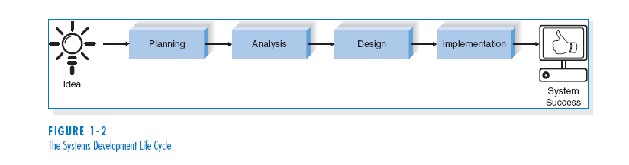
THE SYSTEMS DEVELOPMENT LIFE CYCLE (SDLC)

Slide 12
(cont’d)
The SDLC is composed of four fundamental phases:
Planning
Analysis
Design
Implementation
Each of the phases is composed of steps, which rely on techniques that produce deliverables (specific documents that explain various elements of the system).

Slide 13
Planning
This phase is the fundamental process of understanding why an information system should be built, and determining how the project team will go about building it.

Slide 14
The planning phase has two steps:
1. During project initiation, the system’s business value to the organization is identified (How will it lower costs or increase revenues?).
2. During project management, the project manager creates a work plan, staffs the project, and puts techniques in place to help the project team control and direct the project through the entire SDLC.

Slide 15
Analysis
The analysis phase answers the questions of who will use the system, what the system will do, and where and when it will be used.
During this phase the project team investigates any current system(s), identifies improvement opportunities, and develops a concept for the new system.

Slide 16
The analysis phase has three steps:
1. Analysis strategy: This is developed to guide the projects team’s efforts. This includes a study of the current system and its problems, and envisioning ways to design a new system.
2. Requirements gathering: The analysis of this information leads to the development of a concept for a new system. This concept is used to build a set of analysis models.
3. System proposal: The proposal is presented to the project sponsor and other key individuals who decide whether the project should continue to move forward.

Slide 17
Design
The design phase decides how the system will operate, in terms of the hardware, software, and network infrastructure; the user interface, forms, and reports that will be used; and the specific programs, databases, and files that will be needed.

Slide 18
The design phase has four steps:
1. Design Strategy: This clarifies whether the system will be developed by the company or outside the company.
2. Architecture Design: This describes the hardware, software, and network infrastructure that will be used.
3. Database and File Specifications: These documents define what and where the data will be stored.
4. Program Design: Defines what programs need to be written and what they will do.

Slide 19
Implementation
During the implementation phase, the system is either developed or purchased (in the case of packaged software) and installed.
This phase is usually the longest and most expensive part of the process.

Slide 20
The implementation phase has three steps:
1. System Construction: The system is built and tested to make sure it performs as designed.
2. Installation: The old system is turned off and the new one is turned on.
3. Support Plan: Includes a post-implementation review as well as a systematic way for identifying changes needed for the system.

Slide 21
A systems Development Process:
We examine a systems development process based on a hypothetical methodology called FAST (Framework for the Application of Systems Techniques) ( Whitten , 2007).
Types of system projects and how they get started
Basic FAST phases
Alternative variations or ‘routes’ through the phases
The past section introduced the four classic phases of the SDLC. The FAST methodology employs eight phases to better define periodic milestones and the deliverables.

Slide 22
A systems Development Process: Project Identification and Initiation
System users and owners initiate most projects. The impetus for most projects is some combination of problems, opportunities and directives
Problems are undesirable situations that prevent the organization from fully achieving its purpose, goals, and/or objectives.
Opportunities are chances to improve the organization even in the absence of specific problems.
Directives are new requirements that are imposed by management, government, or some external influence.
Notes:
Teaching Notes
Emphasize that problems, opportunities, and directives can either be planned or unplanned.

Slide 23
The PIECES Problem-Solving Framework
James Wetherbe (1994) developed a useful framework (PIECES) for classifying problems.
P the need to improve performance
I the need to improve information (and data)
E the need to improve economics, control costs, or increase profits
C the need to improve control or security
E the need to improve efficiency of people and processes
S the need to improve service to customers, suppliers, partners, employees, etc.
Notes:
Teaching Tips
We really emphasize PIECES as a useful way to characterize all problems. Later, we teach our students to use PIECES to analyze requirements and solutions as well.
It can be useful to apply the PIECES framework to a project from the instructor’s professional background.

Slide 24
The PIECES Problem-Solving Framework
The following checklist for problem, opportunity, and directive identification uses Wetherbe's PIECES framework. Note that the categories of PIECES are not mutually exclusive; some possible problems show up in multiple lists. Also, the list of possible problems is not exhaustive. The PIECES framework is equally suited to analyzing both manual and computerized systems and applications.
PERFORMANCE Problems, Opportunities, and Directives
A. Throughput – the amount of work performed over some period of time.
B. Response time – the average delay between a transaction or request and a response to that transaction or request
INFORMATION (and Data) Problems, Opportunities, and Directives
A. Outputs
1. Lack of any information
2. Lack of necessary information
3. Lack of relevant information
4. Too much information – ``information overload''
5. Information that is not in a useful format
6. Information that is not accurate
7. Information that is difficult to produce
8. Information is not timely to its subsequent use
Notes:
Figure 3.4 The PIECES Problem-Solving Framework
The categories of the PIECES framework overlap. Any given project can be characterized by one or more categories, and any given problem/opportunity/constraint may have implications with respect to more than one category.
79-81

Slide 25
The PIECES Problem-Solving Framework
INFORMATION (and Data) Problems, Opportunities, and Directives
B. Inputs
1. Data is not captured
2. Data is not captured in time to be useful
3. Data is not accurately captured -- contains errors
4. Data is difficult to capture
5. Data is captured redundantly -- same data captured more than once
6. Too much data is captured
7. Illegal data is captured
C. Stored Data
1. Data is stored redundantly in multiple files and/or databases
2. Stored data is not accurate (may be related to #1)
3. Data is not secure to accident or vandalism
4. Data is not well organized
5. Data is not flexible – not easy to meet new information needs from stored data
6. Data is not accessible
Notes:
Figure 3.4 The PIECES Problem-Solving Framework (continued)
79-81

Slide 26
The PIECES Problem-Solving Framework
ECONOMICS Problems, Opportunities, and Directives
A. Costs
1. Costs are unknown
2. Costs are untraceable to source
3. Costs are too high
B. Profits
1. New markets can be explored
2. Current marketing can be improved
3. Orders can be increased
CONTROL (and Security) Problems, Opportunities, and Directives
A. Too little security or control
1. Input data is not adequately edited
2. Crimes are (or can be) committed against data
a. Fraud
b. Embezzlement
3. Ethics are breached on data or information – refers to data or information letting to unauthorized people
4. Redundantly stored data is inconsistent in different files or databases
Notes:
Figure 3.4 The PIECES Problem-Solving Framework (continued)
79-81

Slide 27
The PIECES Problem-Solving Framework
CONTROL (and Security) Problems, Opportunities, and Directives
A. Too little security or control (continued)
5. Data privacy regulations or guidelines are being (or can be) violated
6. Processing errors are occurring (either by people, machines, or software)
7. Decision-making errors are occurring
B. Too much security or control
1. Bureaucratic red tape slows the system
2. Controls inconvenience customers or employees
3. Excessive controls cause processing delays
EFFICIENCY Problems, Opportunities, and Directives
A. People, machines, or computers waste time
1. Data is redundantly input or copied
2. Data is redundantly processed
3. Information is redundantly generated
B. People, machines, or computers waste materials and supplies
C. Effort required for tasks is excessive
D. Materials required for tasks is excessive
Notes:
Figure 3.4 The PIECES Problem-Solving Framework (continued)
79-81

Slide 28
The PIECES Problem-Solving Framework
SERVICE Problems, Opportunities, and Directives
A. The system produces inaccurate results
B. The system produces inconsistent results
C. The system produces unreliable results
D. The system is not easy to learn
E. The system is not easy to use
F. The system is awkward to use
G. The system is inflexible to new or exceptional situations
H. The system is inflexible to change
I. The system is incompatible with other systems
J. The system is not coordinated with other systems
Notes:
Figure 3.4 The PIECES Problem-Solving Framework (continued)
79-81

Slide 29
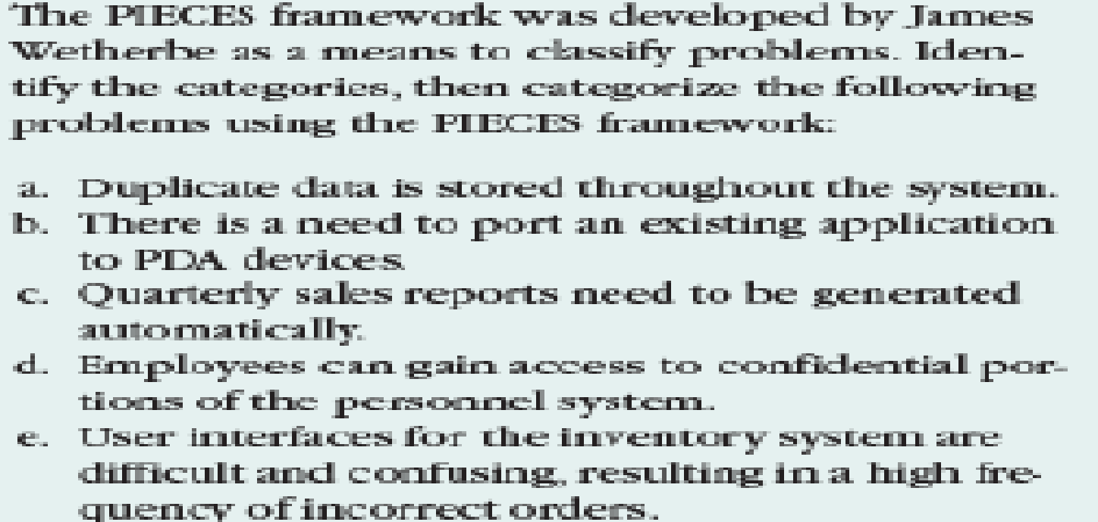
Exercise 1

Slide 30
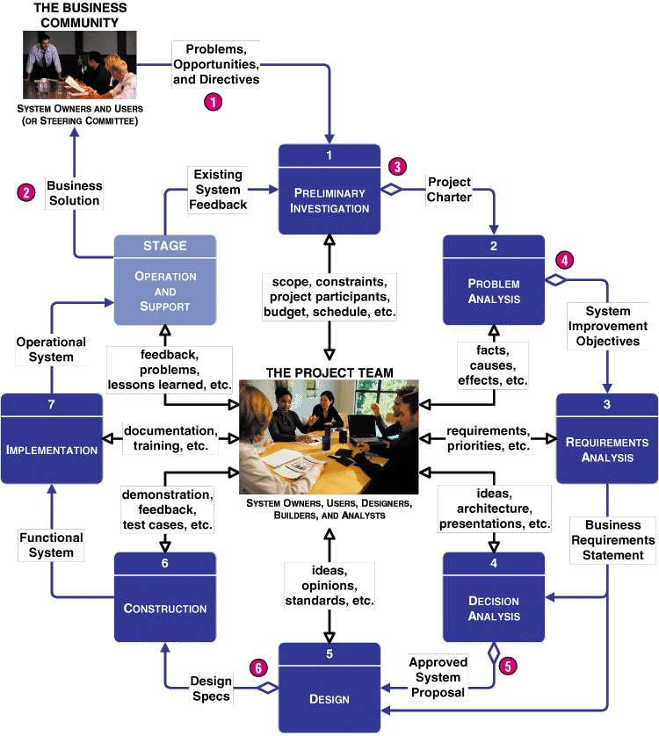
FAST System Development Phases
Notes:
Teaching Notes
A hypothetical methodology called FAST (Framework for the Application of System Techniques) is used to teach a representative, implementation of a system development process

Slide 31
Project Phases
Preliminary investigation phase
Purpose:
The purpose of the survey phase is threefold.
The survey phase answers the question, “Is this project worth looking at?”
The survey phase must define the scope of the project and the perceived problems, opportunities, and directives that triggered the project.
The survey phase must establish the preliminary requirements and constraints, project team and participants, the project budget, and the project schedule.
Ultimately, this phase concludes with a ‘go or no-go’ decision from system owners

Slide 32
Project Phases:
Preliminary investigation cont.
A key deliverable for the survey phase is a project charter that presents the findings, recommendations, and plans of the team to the executive sponsors.
This might be a report or verbal presentation; possibly both.
The report version is sometimes called an initial study report.
The analyst's recommendation may prescribe:
a ``quick fix,''
an enhancement of the existing system and software
a completely new information system.
For the latter possibility, a statement of project scope and objectives is delivered to the problem analysis phase.

Slide 33
Project Phases
Problem analysis phase- provides for a study and analysis of the existing system – more thorough understanding of the problems that triggered the project.
Deliverables
The findings of the study phase are reviewed with the system owners as a business problem statement and feasibility analysis (sometimes called a detailed study report).
The problem statement may take the form of a formal written report, an updated feasibility assessment, or a formal presentation to management and users.
The problem statement should include system improvement objectives. These objectives define the business criteria on which any new system will be evaluated.

Slide 34
Project Phases
Requirements analysis phase – defines and prioritizes the business requirements. The analyst approaches the users to find out what they need or want out of the new system. Errors and omissions result in user dissatisfaction with the final system and costly modifications.
The purpose of requirements analysis is to identify the data, process, interface, and geographic requirements for the users of a new system.
Specify these requirements without expressing computer alternatives and technology details; at this point, keep analysis at the business level
The deliverable of this phase is a business requirements statement.
The requirements statement becomes the trigger for systems design.

Slide 35
Project Phases
Decision Analysis Phase – given the business requirements statement, there are usually numerous alternative ways to design a new information system to fulfill those requirements. This phase identifies candidate solutions, analyzes them for feasibility and recommends a candidate system as the target solution to be designed. This candidate is evaluated by the following criteria:
Technical feasibility. Is the solution technically practical? Does our staff have the technical expertise to design and build this solution?
Operational feasibility. Will the solution fulfill the user's requirements? To what degree? How will the solution change the user's work environment? How do users feel about such a solution?
Economic feasibility. Is the solution cost-effective (as defined earlier in the chapter)?
Schedule feasibility. Can the solution be designed and implemented within an acceptable time period?
The key deliverable of the targeting phase is a formal systems proposal to systems owners.

Slide 36
Project phases
Design phase – is concerned with technology based views of the system’s data, processes and interfaces.
The purpose of the design phase is to transform the business requirements from the definition phase into a set of technical design blueprints for construction.
A project is rarely cancelled after the design phase unless it is hopelessly overbudget or behind schedule.
Deliverables
The final deliverable is a technical set of design specifications.
Design specifications can take several forms, but the most common approach is modeling.
General design models will depict:
The structure of the database.
The structure of the overall application.
The overall ‘look and feel’ of the user interface.
The structure of the computer network.
The design structures for any complex software to be written.

Slide 37
Project Phases
Construction phase – The purpose of the construction phase is to build and test a functional system that fulfills business and design requirements
System components are built. The components are tested individually and then linked and tested again to ensure that they hang together properly without causing the system to crash.
Deliverables
The final deliverable of the construction phase is the functional system.

Slide 38
Project phases
Implementation phase – delivers the production system into operation. The analyst must provide for a smooth transition from the old to new system, and help users cope with normal start-up problems. This phase also involves training individuals that will use the final system and developing documentation to aid system users.

Slide 39
Project Phases
Operation and support stage – Once the system is placed into production, the analyst's role changes to systems support.
System support is the ongoing maintenance of a system after it has been placed into operation. This includes program maintenance and system improvements.
Systems support doesn't consist of phases so much as it does ongoing activities. These activities include:
Fixing software ‘bugs’.
Recovering the system.
Assisting users.
Adapting the system to new requirements.
Eventually, we expect the user feedback and problems to indicate that it is time to start over and reinvent the system.

Slide 40
Overlap of System Development Phases
2001
2002
ID
Task Name
May
Jun
Jul
Aug
Sep
Oct
Nov
Dec
Jan
1
Project management
2
Preliminary investigation
3
Problem analysis
4
Requirements analysis
5
Decision analysis
6
Design
7
Construction
8
Implementation
9
Operations and support
Notes:
Teaching Notes
Every project is different depending on the size, complexity, and development methodology or route. The key point to emphasize in the figure is that the phases occur in parallel. It is important that students not misinterpret that the phases in this chapter are sequential.
Note that project and process management are illustrated as ongoing activities that last the duration of a project. (The next chapter will focus on project and process management as well as the construction and use of Gantt Charts such as the one above.)

Slide 41
Cross Life Cycle Activities
Cross life cycle activities are activities that overlap many or all phases of the methodology.
fact finding
documentation and presentation
estimation and measurement
feasibility analysis
project management
process management.
Notes:
No additional notes.

Slide 42
Sequential vs Iterative Development approach
The sequential approach as depicted in the SDLC and FAST methodology requires each phase be ‘completed’ one after the other until the information system is finished. This approach is sometimes called the waterfall development approach
An approach that is increasingly gaining popularity is the iterative development approach, or incremental development process.
This approach requires completing enough analysis, design and implementation to develop a part of of the system and place it into operation, then perform additional analysis, design and implementation to release the next version, and this continues until all parts of the entire IS have been implemented
This allows versions of useable IS to be delivered in regular and shorter time frames as opposed to the time taken using the waterfall approach, which may result in improved customer (system owner and user) satisfaction

Slide 43
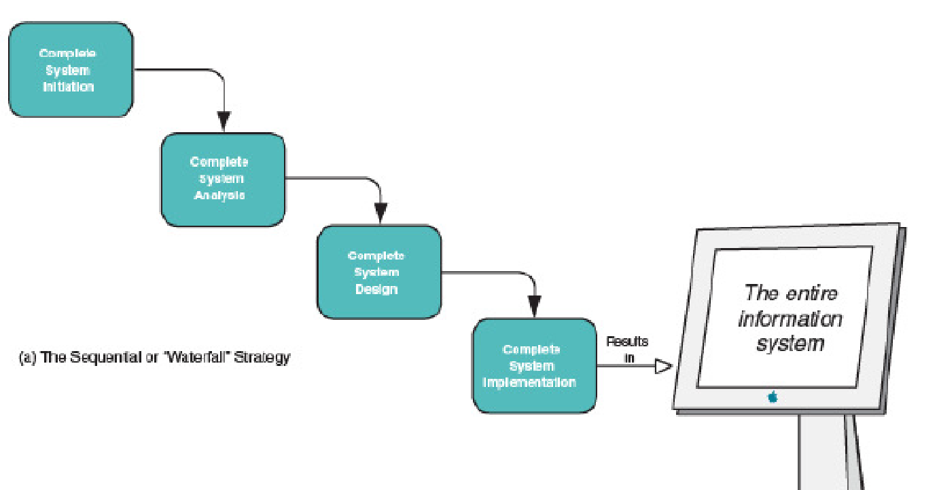
The sequential or waterfall model

Slide 44
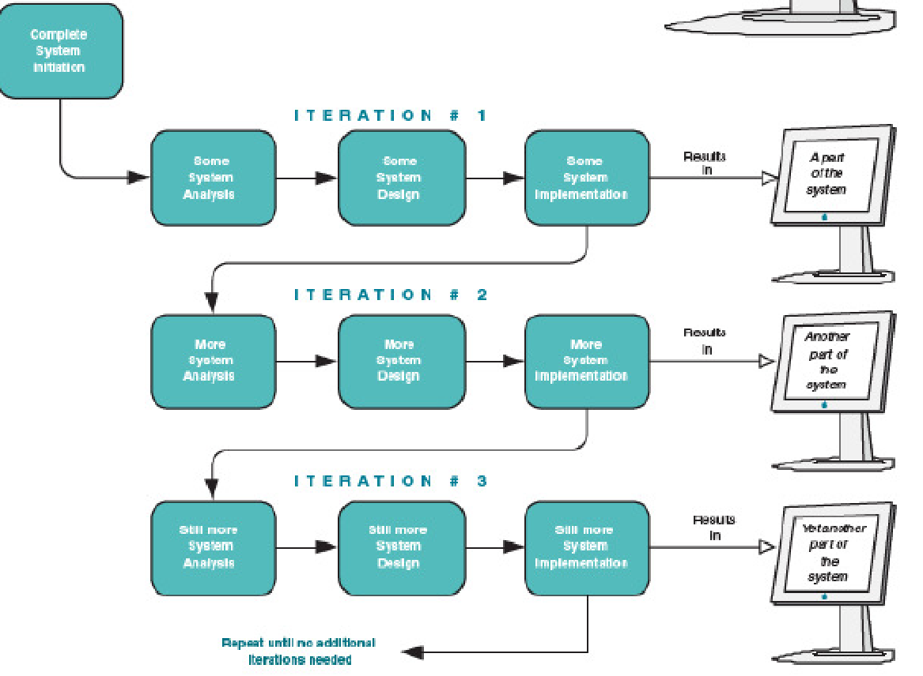
The iterative or incremental strategy

Slide 45
Alternative Routes through a Methodology
Model-Driven Development (MDD)
Rapid Application Development (RAD)
Commercial Off-the-Shelf Software (COTS)
or hybrids of the above
Notes:
Teaching Notes
In this edition, we have formally acknowledged the notion that there can be multiple strategies or “routes” through the traditional phases. Thus, “one size does not fit all projects.”
We have included a few of the more common routes, but there are literally dozens of routes and hundreds of variations in many methodologies. A key precept is that, contrary to popular marketing and consulting hype, the routes are merely different implementations of the same basic phases already covered (usually cleverly disguised in proprietary languages and terminology). Different routes emphasize different phases, tools, and techniques.

Slide 46
Model-Driven Development Route
Modeling is the act of drawing one or more graphical representations (or pictures) of a system. Modeling is a communication technique based upon the old saying, “a picture is worth a thousand words.”
Model-driven development techniques emphasize the drawing of models to help visualize and analyze problems, define business requirements, and design information systems.
Advantages?
Disadvantages?
Notes:
Conversion Notes
The model-driven “route” is most typically associated with “methodologies based on structured analysis and design, information engineering (data modeling), or object-oriented analysis and design (use-case, UML, etc.).

Slide 47
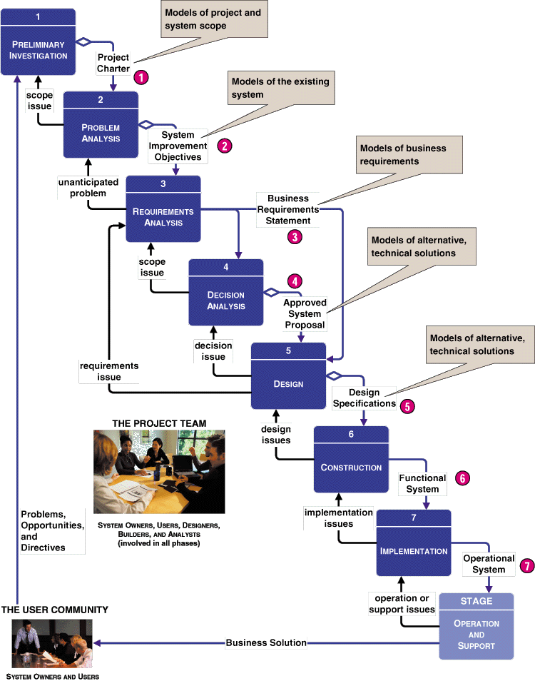
Model-Driven Development (MDD) Route
Notes:
Teaching Notes
The model-driven approach (with the notable exception of OOAD) is most commonly associated with the “waterfall” approach to system development. While often criticized for its time and effort intensity, model-driven strategies still work well with large and unstructured problem domains.

Slide 48
Rapid Application Development Route
Rapid application development (RAD) techniques emphasize extensive user involvement in the rapid and evolutionary construction of working prototypes of a system to accelerate the system development process. RAD is based on building prototypes that evolve into finished systems (often using time boxing)
A prototype is a smaller-scale, representative or working model of the users’ requirements or a proposed design for an information system.
A time box is a nonextendable period of time, usually 60-120 days, by which a candidate system must be placed into operation.
Notes:
Conversion Notes
The rapid application development “route” is most typically associated with prototyping, JAD, and incremental or iterative approaches to system development.

Slide 49
Rapid Application Development Route
RAD Basic ideas
To more actively involve system users in the analysis, design and construction activities
To organize system development into a series of focused, intense workshops jointly involving system owners, users, analysts, designers and builders
To accelerate the requirements analysis and design phases through an iterative construction approach
To reduce the amount of time until the users begin to see a working system
Advantages?
Disadvantages?

Slide 50
Commercial Off-the-Shelf Software Route
Commercial off-the-shelf (COTS) software is a software package or solution that is purchased to support one or more business functions and information systems.
Packaged software solutions must be carefully selected to fulfil business needs. They are not only costly to purchase, but can also be costly to implement. They might usually be customized for and integrated into the business, or may require the redesign of existing business processes to adapt to the software.
Advantages?
Disadvantages?
Notes:
Conversion Notes
This “route” is new to this edition.
This route replaces the “procurement” phase of the previous edition’s methodology.
COTS has become extraordinarily important to aspiring systems analysts because an ever-increasing percentage of all information systems are purchased, not built in-house.
This edition of the textbook includes new chapters that specifically focus on software procurement and systems integration caused by software procurement.
Teaching Tips
Emphasize to students that tomorrow’s systems analysts will be as likely to participate in a software package selection and integration as they will in a traditional design-and-construction style project.

Slide 51
Automated Tools and Technology: Computer-Aided Systems Engineering (CASE)
What is Computer-Aided Systems Engineering?
Computer-aided systems engineering (CASE) is the application of information technology to systems development activities, techniques, and methodologies. CASE tools are programs (software) that automate or support one or more phases of a systems development life cycle. The technology is intended to accelerate the process of developing systems and to improve the quality of the resulting systems.
CASE is not a methodology or an alternative to methodologies.
CASE is an enabling technology that supports a methodology’s preferred strategies, techniques, and deliverables.
Notes:
Conversion Notes
In this edition, we discontinued the distinction between upper- and lower-CASE technology using those adjectives. Instead, we used more modern terminology as follows: Fifth Edition Fourth Edition CASE upper-CASE ADE lower-CASE
All non-CASE or non-ADE automated tools were classified as “process and project managers.”

Slide 52
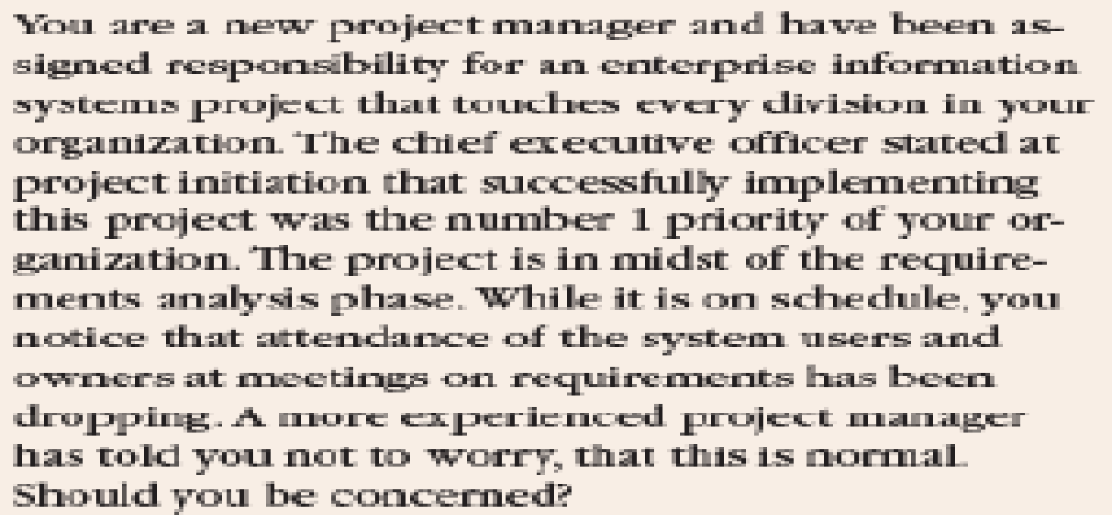
Exercise 2

